Slide 1



WELC0ME

Slide 2



Introduction
Ilene Sorto
Aspiring Data Scientist

Slide 3

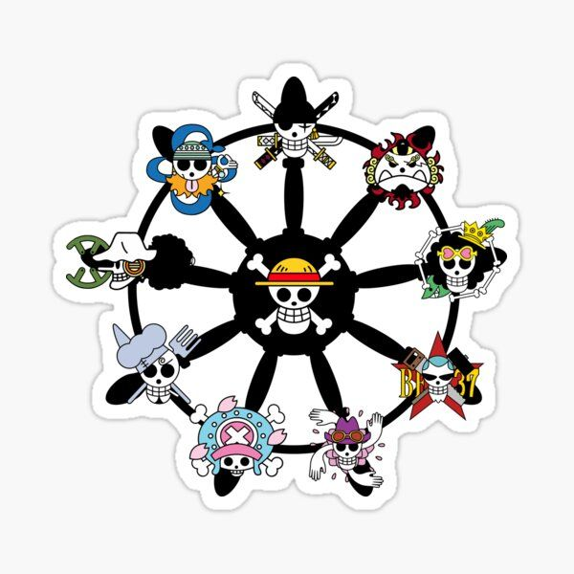




AGENDA
Business problem
Data & Methods
Results
Proposals
Future actions

Slide 4




Business problem
add text add text add text add text add text add text add text add text add text add text add text add text add text add text add text add text add text add text add text add text add text add text add text add text add text add text add text add text add text add text add text add text add text add text add text add text

Slide 5





TITLE
add text add text add text add text add text add text add text add text add text add text add text add text add text add text add text add text add text add text add text add text add text add text add text add text add text add text add text add text add text add text add text add text add text add text add text add text

Slide 6


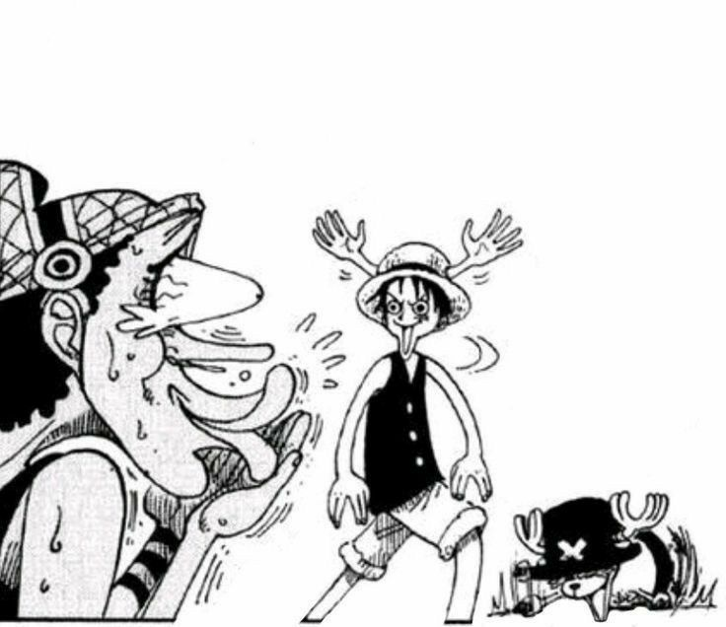

TITLE
add text add text add text add text add text add text add text add text add text add text add text add text add text add text add text add text add text add text add text add text add text add text add text add text add text add text add text add text add text add text add text add text add text add text add text add text

Slide 7

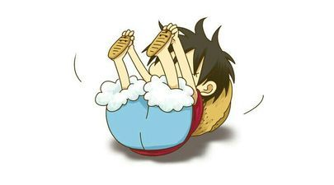


TITLE
Graduation
Your text has been concise and beautiful, But the information is inextricably inextricable and needs to be expressed in more words; But please refine the essence of your thought as much as possible, Otherwise it is easy to cause the reading pressure of the viewer, Which is counterproductive.
Demonstrate
Demonstrate
Demonstrate
Demonstrate
But the information is inextricably inextricable and needs to be expressed in more words;
But the information is inextricably inextricable and needs to be expressed in more words;
But the information is inextricably inextricable and needs to be expressed in more words;
But the information is inextricably inextricable and needs to be expressed in more words;

Slide 8

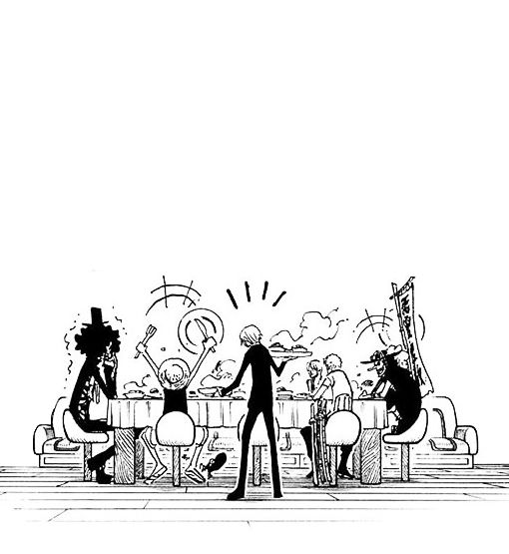

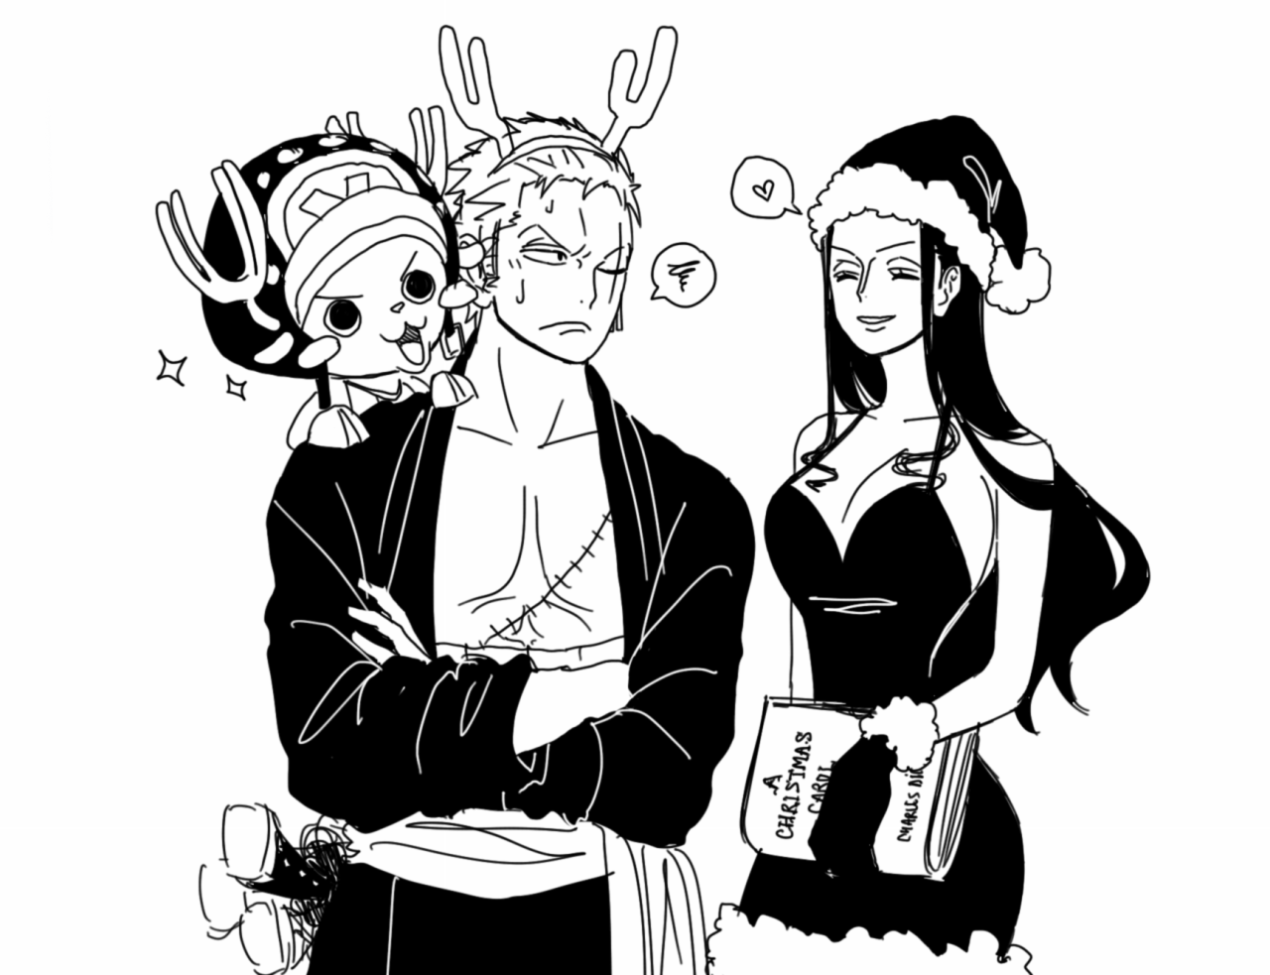
TITLE
Demonstrate
But the information is inextricably inextricable and needs to be expressed in more words
Demonstrate
But the information is inextricably inextricable and needs to be expressed in more words
Demonstrate
But the information is inextricably inextricable and needs to be expressed in more words

Slide 9




ANY QUESTION ???

Slide 10



THANK YOU
THANK YOU

